Slide 1
Chapter 5
Number Representation and Arithmetic Circuits
Chapter Objectives
In this chapter you will learn about:
• Representation of numbers in computers
• Circuits used to perform arithmetic operations

Slide 2
Unsigned Integers
Numbers that are positive only are called unsigned numbers, and numbers that can also be negative are called signed numbers.
Representation of numbers that include a radix point => real numbers
In the familiar decimal system:
a number consists of digits that have 10 possible values from 0 to 9.
each digit represents a multiple of a power of 10.
For example, the number 8547 represents 8 × 10³ + 5 × 10² + 4 × 10¹ + 7 × 10⁰.
But, we do not normally write the powers of 10 with the number, because they are implied by the positions of the digits.

Slide 3
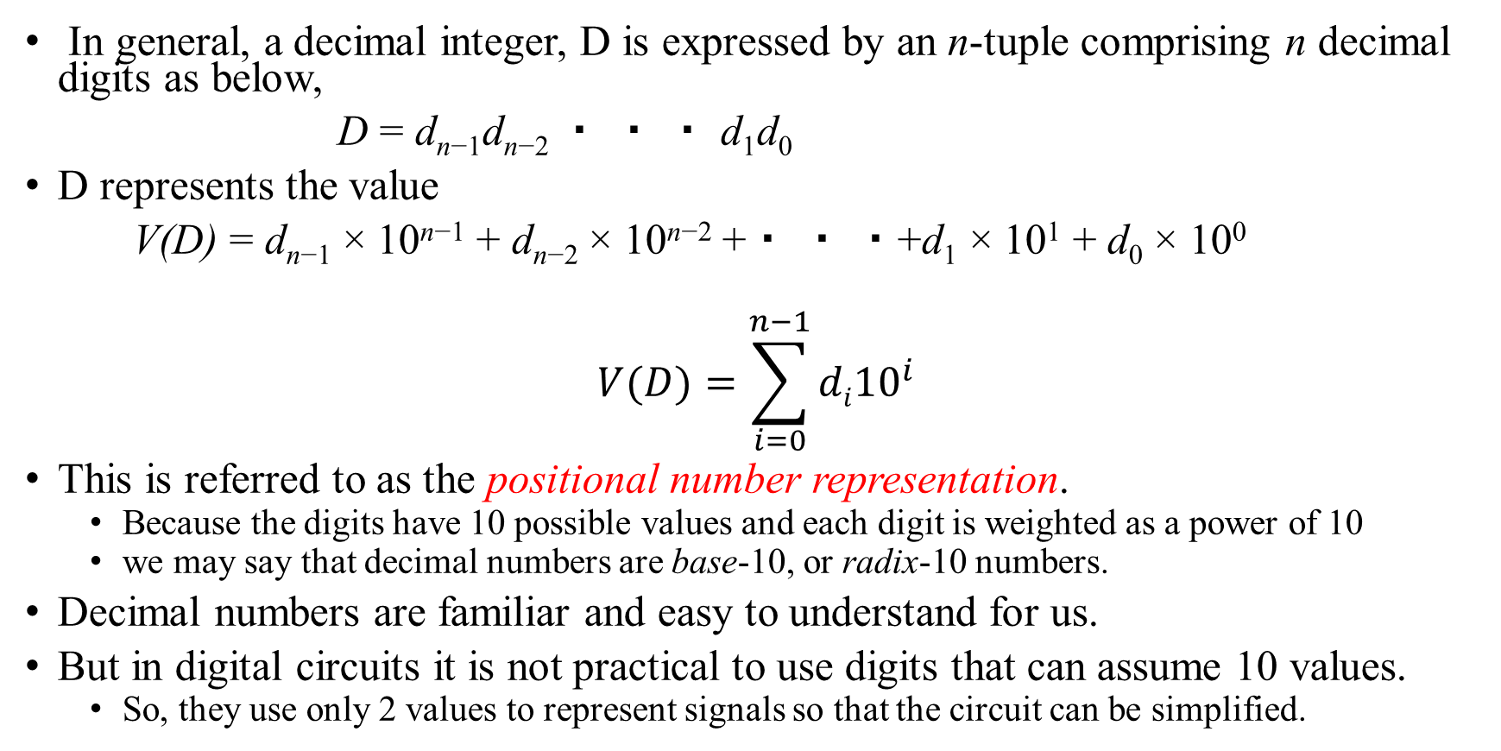
Positional Number Representation
In general, a decimal integer, D is expressed by an n-tuple comprising n decimal digits as below,
D = d_{n−1}d_{n−2} ・ ・ ・ d₁d₀
D represents the value
V(D) = d_{n−1} × 10^{n−1} + d_{n−2} × 10^{n−2} +・ ・ ・+d₁ × 10¹ + d₀ × 10⁰
$$V(D)=\sum_{i=0}^{n−1}{di{10}^{i}}$$
This is referred to as the positional number representation.
Because the digits have 10 possible values and each digit is weighted as a power of 10
we may say that decimal numbers are base-10, or radix-10 numbers.
Decimal numbers are familiar and easy to understand for us.
But in digital circuits it is not practical to use digits that can assume 10 values.
So, they use only 2 values to represent signals so that the circuit can be simplified.

Slide 4
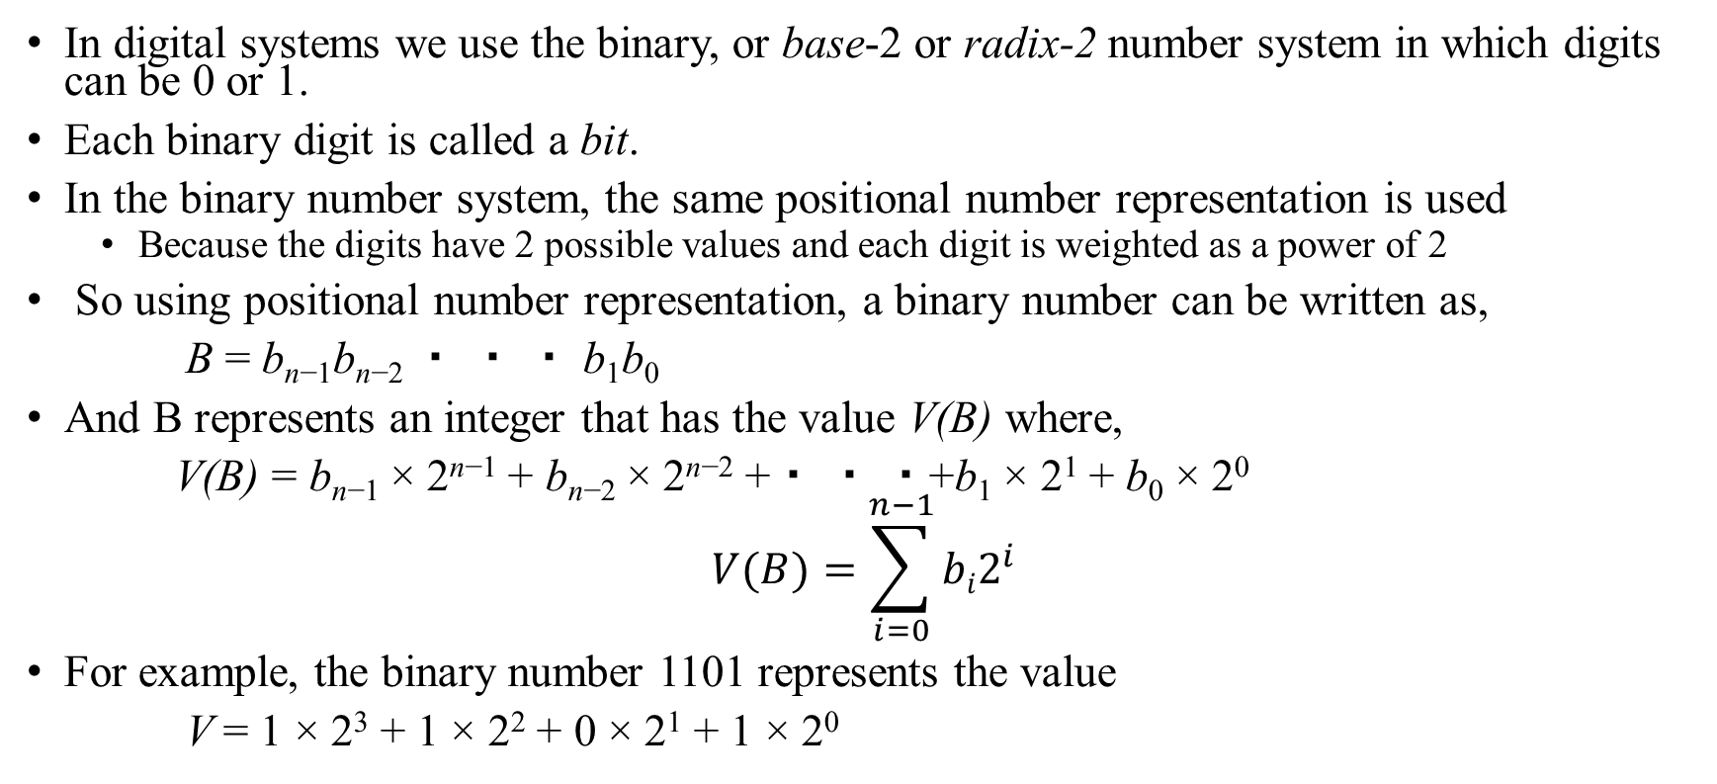
Binary Number System
In digital systems we use the binary, or base-2 or radix-2 number system in which digits can be 0 or 1.
Each binary digit is called a bit.
In the binary number system, the same positional number representation is used
Because the digits have 2 possible values and each digit is weighted as a power of 2
So using positional number representation, a binary number can be written as,
B = b_{n−1}b_{n−2} ・ ・ ・ b₁b₀
And B represents an integer that has the value V(B) where,
V(B) = b_{n−1} × 2^{n−1} + b_{n−2} × 2^{n−2} +・ ・ ・+b₁ × 2¹ + b₀ × 2⁰
$$V(B)=\sum_{i=0}^{n−1}{bi2^{i}}$$
For example, the binary number 1101 represents the value
V = 1 × 2³ + 1 × 2² + 0 × 2¹ + 1 × 2⁰

Slide 5
Contd..
We can indicate the radix as a subscript when there is potential for confusion.
So, 1101 is a base-2 number, and we shall write it as (1101)₂.
Evaluating the preceding expression for V
=> V = 1 × 2³ + 1 × 2² + 0 × 2¹ + 1 × 2⁰ = 8 + 4 + 1 = 13.
Hence (1101)₂ = (13)₁₀
The range of integers that can be represented by a binary number depends on the number of bits used.
For example, with four bits the largest number is (1111)₂ = (15)₁₀.
An example of a larger number is (10110111)₂ = (183)₁₀.
In general, using n bits allows representation of integers in the range 0 to 2^{n −1}

Slide 6
Contd..
In a binary number the right-most bit is usually referred to as the least-significant bit (LSB).
The left-most bit of an unsigned integer, which has the highest power of 2 associated with it, is called the most-significant bit (MSB).
In digital systems it is often convenient to consider several bits together as a group.
A group of four bits is called a nibble
A group of eight bits is called a byte.

Slide 7
Conversion between Decimal and Binary Numbers
A binary number is converted into a decimal number simply by applying the previous equation and evaluating it using decimal arithmetic.
Ex. (1110)₂ = (1 × 2³ + 1 × 2² + 1 × 2¹ + 0 × 2⁰)₁₀ = (8 + 4 + 2)₁₀ = (14)₁₀
Converting a decimal number into a binary number is not quite as straightforward.
The conversion can be performed by successively dividing the decimal number by 2 as follows.
Suppose that a decimal number D = d_{k−1} ・ ・ ・ d₁d₀, with a value V, is to be converted into a binary number B = b_{n−1} ・ ・ ・ b₂b₁b₀.
Thus V = b_{n−1} × 2^{n−1} +・ ・ ・+b₂ × 2² + b₁ × 2¹ + b₀
If we divide V by 2, the result is
V/2= b_{n−1} × 2^{n−2} +・ ・ ・+b₂ × 2¹ + b₁ + b₀/2
The quotient of this integer division is b_{n−1} ×2^{n−2} +・ ・ ・+b₂ ×2+b₁, and the remainder is b₀.

Slide 8
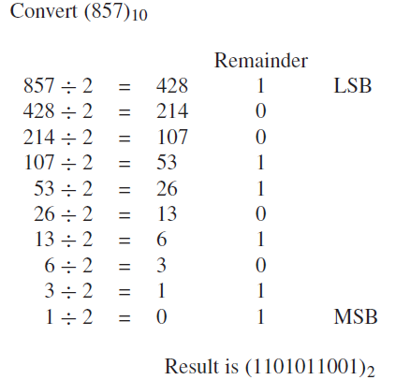
Contd..
The quotient of this integer division is b_{n−1} ×2^{n−2} +・ ・ ・+b₂ ×2+b₁, and the remainder is b₀.
If the remainder is 0, then b₀ = 0; if it is 1, then b₀ = 1.
We can see that the quotient is just another binary number but with n − 1 bits rather than n bits.
Now, dividing the quotient by 2 yields the remainder b₁ and the new quotient is b_{n−1} × 2^{n−3} +・ ・ ・+b₂
Continuing the process of dividing the new quotient by 2, and determining one bit in each step, will produce all bits of the binary number.
The process continues until the quotient becomes 0.
The Figure illustrates the conversion process, using the example (857)₁₀ = (1101011001)₂.
Note that the least-significant bit (LSB) is generated first and the most significant bit (MSB) is generated last.

Slide 9
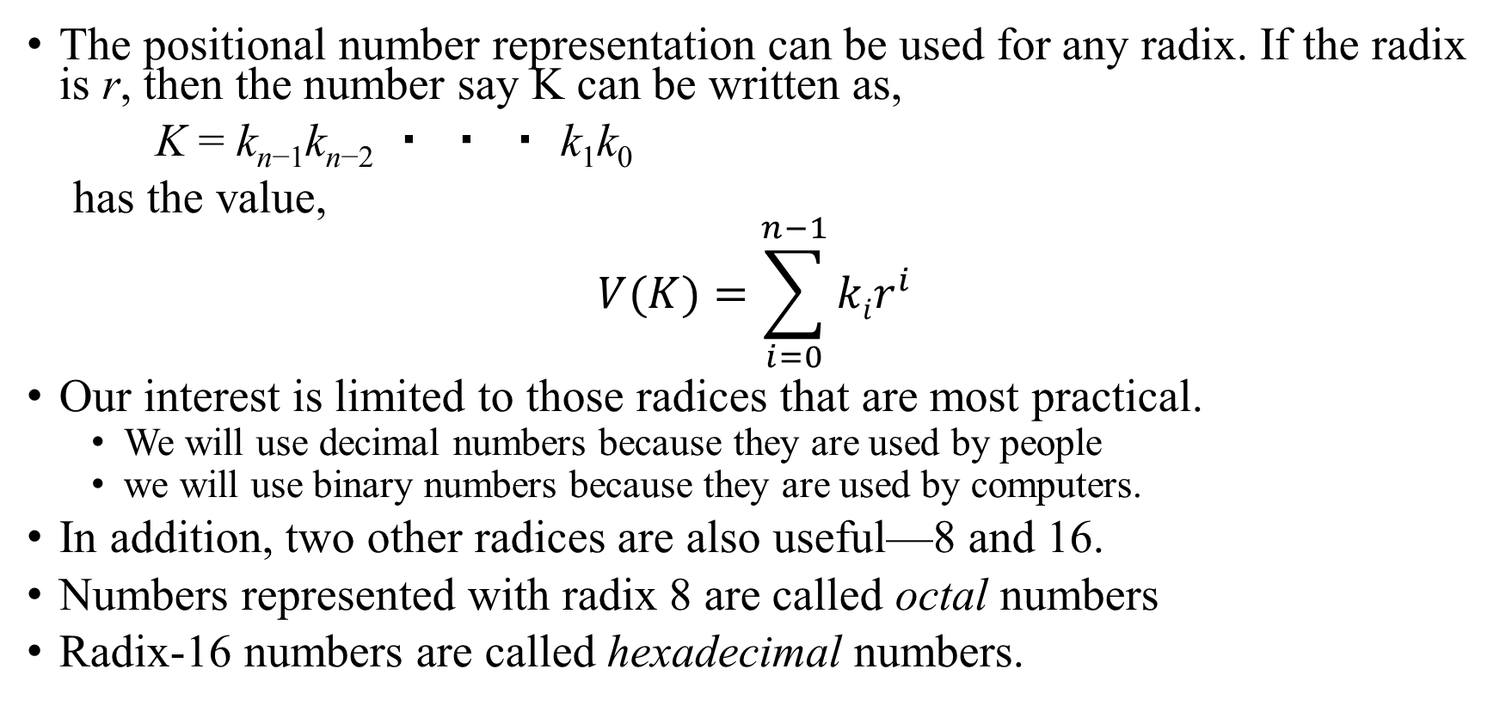
Octal and Hexadecimal Representations
The positional number representation can be used for any radix. If the radix is r, then the number say K can be written as,
K = k_{n−1}k_{n−2} ・ ・ ・ k₁k₀
has the value,
$$V(K)=\sum_{i=0}^{n−1}{kir^{i}}$$
Our interest is limited to those radices that are most practical.
We will use decimal numbers because they are used by people
we will use binary numbers because they are used by computers.
In addition, two other radices are also useful—8 and 16.
Numbers represented with radix 8 are called octal numbers
Radix-16 numbers are called hexadecimal numbers.

Slide 10
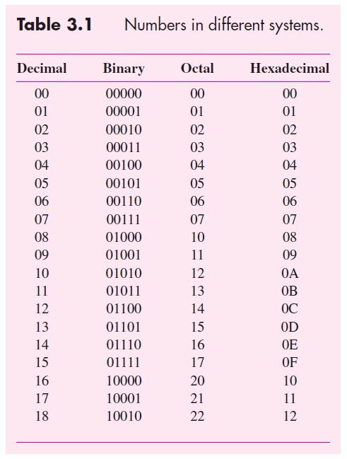
Contd..
In octal representation the digit values range from 0 to 7.
In hexadecimal representation (often abbreviated as hex), each digit can have one of 16 values.
The first ten are denoted the same as in the decimal system, namely, 0 to 9.
Digits that correspond to the decimal values 10, 11, 12, 13, 14, and 15 are denoted by the letters, A, B, C, D, E, and F
In computers the dominant number system is binary.
The reason for using the octal and hexadecimal systems is that they serve as a useful shorthand notation for binary numbers.

Slide 11

Conversion between Octal and Binary Numbers
One octal digit represents three binary bits.
Thus a binary number is converted into an octal number by:
Take as groups of three bits starting from LSB, and
Replacing each of the group with the corresponding octal digit.
For example, 101011010111 is converted as
which means that (101011010111)₂ = (5327)₈.

Slide 12

Contd..
If the number of bits is not a multiple of three, then we can add 0s to the left of the MSB.
For example, consider, (10111011)₂
Hence, (10111011)₂ = (273)₈
Conversion from octal to binary is just as straightforward
each octal digit is simply replaced by three bits that denote the same value.

Slide 13

Conversion between hexadecimal and Binary Numbers
A hexadecimal digit represents four bits.
Thus a binary number is converted into an hexadecimal number by:
Take as groups of four bits starting from LSB, and
Replacing each of the group with the corresponding hexadecimal digit.
For example, a 16-bit binary number, (1010111100100101)₂ can be represented as,
Hence, (1010111100100101)₂ = (AF25)₁₆

Slide 14

Contd..
Zeros are added to the left of the MSB if the number of bits is not a multiple of four.
For example, (1101101000)₂ = (368)₁₆ because of the grouping
Conversion from hexadecimal to binary involves straightforward substitution of each hex digit by four bits that denote the same value.
Binary numbers used in modern computers generally have 32 or 64 bits.
Written as binary n-tuples (sometimes called bit vectors)
Such numbers are awkward to deal with due to their length.
However, it is much simpler to deal with them in the form of 8- or 16-digit hex numbers.

Slide 15
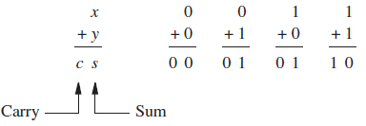
Addition of Unsigned Numbers
Because the arithmetic operations in a digital system usually involve binary numbers, we will now focus on circuits that use such numbers.
Binary addition is performed in the same way as decimal addition except that the values of individual digits can be only 0 or 1.
The addition of 2 one-bit numbers entails four possible combinations as below.
Two bits are needed to represent the result of the addition. The right-most bit is called the sum, s.
The left-most bit, which is produced as a carry-out when both bits being added are equal to 1, is called the carry, c.

Slide 16
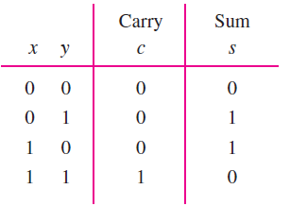
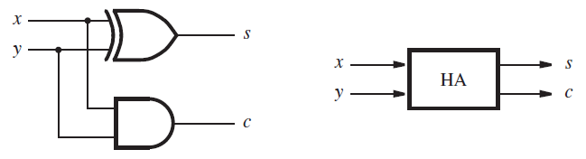
Half-adder
The addition operation can be defined in the form of a truth table as,
The sum bit s is the XOR function. The carry c is the AND function of inputs x and y.
A circuit realization of these functions is shown in Figure.
This circuit, which implements the addition of only two bits, is called a half-adder (HA).

Slide 17
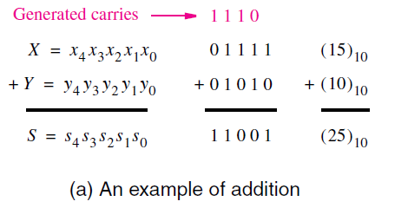
Addition of multibit numbers.
In the case of larger numbers, multiple bits are involved.
Then it is still necessary to add each pair of bits, but for each bit position i, the addition operation may include a carry-in from bit position i − 1.
Consider the example,
Figure presents an example of the addition operation. The two operands are X = (01111)₂ = (15)₁₀ and Y = (01010)₂ = (10)₁₀.
Individual bits are labelled such that X = x₄x₃x₂x₁x₀ and Y = y₄y₃y₂y₁y₀.
Hence, the sum S = X + Y = (25)₁₀ can also be denoted as a five-bit integer.

Slide 18
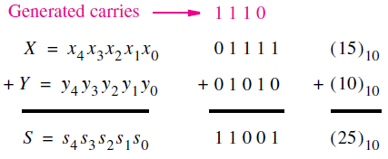
Contd..
The carries generated during the addition process are marked in pink colour.
For example, a carry of 0 is generated when x₀ and y₀ are added, a carry of 1 is produced when x₁ and y₁ are added, and so on.
Designing the adder circuit after forming of a truth table is impractical here:
Truth table would have 10 input variables.
5 for each number X and Y .
So it would have 2¹⁰ = 1024 rows

Slide 19
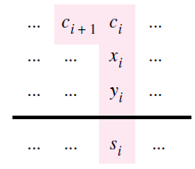
Contd..
A better approach in design is to consider the addition of each pair of bits, x_{i} and y_{i} , separately.
For bit position 0, there is no carry-in, and hence the addition is the same as Half Adder.
For each other bit position i, the addition involves bits x_{i} and y_{i} , and a carry-in c_{i} , as illustrated in figure.

Slide 20
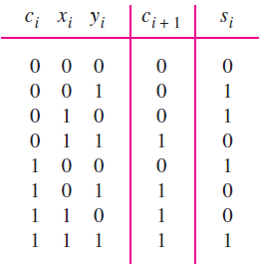
Contd..
So, the logic circuit will have three inputs x_{i}, y_{i}, and c_{i} , and produces the two outputs s_{i} and c_{i+1}.
The required truth table is as shown.
The sum bit, s_{i} , is the modulo-2 sum of x_{i}, y_{i}, and c_{i}.
The carry-out, c_{i+1}, is equal to 1 if the sum of x_{i} , y_{i} , and c_{i} is equal to either 2 or 3.
The logic circuit implementing the truth table is called as a full-adder.

Slide 21
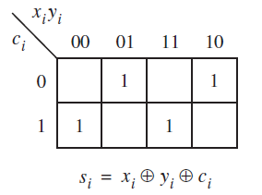
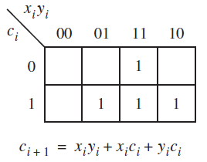
Contd..
Karnaugh maps for the sum and carry are shown below.
For the carry-out function the optimal sum-of-products realization is
c_{i+1} = x_{i}y_{i} + x_{i}c_{i} + y_{i}c_{i}
For the s_{i} function a sum-of-products realization is

Slide 22
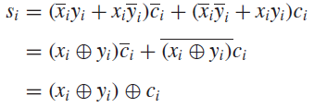
Use of XOR Gates
A more attractive way of implementing this function is by using the XOR gates, as given below.
The XOR function of two variables is defined as
The preceding expression for the sum bit can be manipulated into a form that uses only XOR operations as follows
The XOR operation is associative hence we can write
Therefore, a three-input XOR operation can be used to realize s_{i}.

Slide 23
Contd..
The XOR operation generates as an output a modulo-2 sum of its inputs.
Thus, the output is equal to 1 if an odd number of inputs have the value 1, and it is equal to 0 otherwise.
For this reason the XOR is sometimes referred to as the odd function.
Observe that the XOR has no minterms that can be combined into a larger product term, as evident from the checkerboard pattern for function s_{i} in the map.

Slide 24
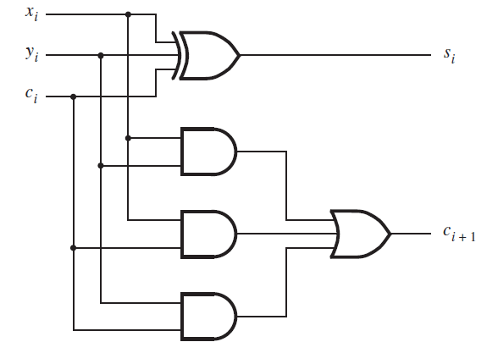
Full Adder circuit
c_{i+1} = x_{i}y_{i} + x_{i}c_{i} + y_{i}c_{i}

Slide 25
More about XOR gates..
A two-input XOR gate can also be thought of as using one input as a control signal that determines whether the true or complemented value of the other input will be passed through the gate as the output value.
This can be verified from the definition of XOR operation,
Consider x₁ to be the control input. Then if x₁ = 0, the output will be equal to the value of x₂.
But if x₁ = 1, the output will be equal to the complement of x₂.

Slide 26
Contd..
In the earlier derivation, we used algebraic manipulation to derive s_{i}
s_{i} = (x_{i} ⊕ y_{i}) ⊕ c_{i} .
We could have obtained the same expression immediately by making the following observation.
In the top half of the truth table, c_{i} is equal to 0, and the sum function s_{i} is the XOR of x_{i} and y_{i} .
In the bottom half of the table, c_{i} is equal to 1, while s_{i} is the complemented version of its top half.
This observation leads directly to our expression using 2 two-input XOR operations.
In the preceding discussion we encountered the complement of the XOR called as XNOR denoted by ( )
The XNOR is sometimes also referred to as the coincidence operation
because it produces the output of 1 when its inputs coincide in value; that is, they are both 0 or both 1.

Slide 27
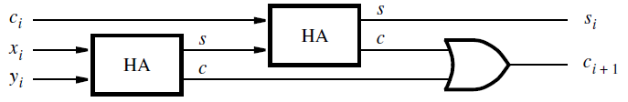
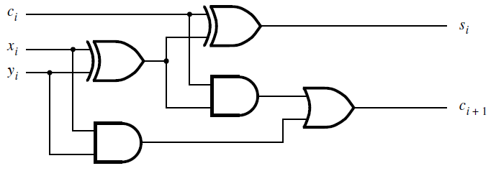
Decomposed Full-Adder
In view of the names used for the circuits, one can expect that a full-adder can be constructed using half-adders.
This can be accomplished by creating a circuit given in figure.
It uses two half-adders to form a full-adder.

Slide 28
Ripple Carry Adder - Multibit adder
To perform addition by hand, we start from the least-significant digit and add pairs of digits, progressing to the most-significant digit.
If a carry is produced in position i, then this carry is added to the operands in position i + 1.
The same arrangement can be used in a logic circuit that performs addition.
Hence, for each bit position we can use a full-adder circuit.

Slide 29
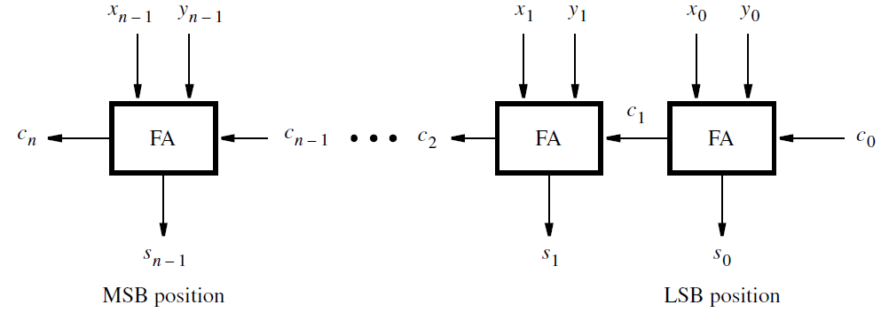
An n-bit ripple-carry adder
The addition of such numbers does not require a carry-in for stage 0.
In Figure, we included c₀ in the diagram so that the ripple-carry adder can also be used for subtraction of numbers (will study in next topic)
Carries that are produced by the full-adders propagate to the left.

Slide 30
Delay in ripple carry adder
When the operands X and Y are applied as inputs to the adder, it takes some time before the output sum, S, is valid.
Each full-adder introduces a certain delay before its s_{i} and c_{i+1} outputs are valid.
Let this delay be denoted as Δt.
Thus the carry-out from the first stage, c₁, arrives at the second stage Δt after the application of the x₀ and y₀ inputs.
The carry-out from the second stage, c₂, arrives at the third stage with a 2Δt delay, and so on.

Slide 31
Contd..
The signal c_{n−1} is valid after a delay of (n − 1)Δt, which means that the complete sum is available after a delay of nΔt.
Because of the way the carry signals “ripple” through the full-adder stages, this n-bit adder circuit is called a ripple-carry adder.
The delay incurred to produce the final sum and carry-out in a ripple-carry adder depends on the size of the numbers.
When 32- or 64-bit numbers are used, this delay may become unacceptably high.
So, other implementations will have to adopted

Slide 32
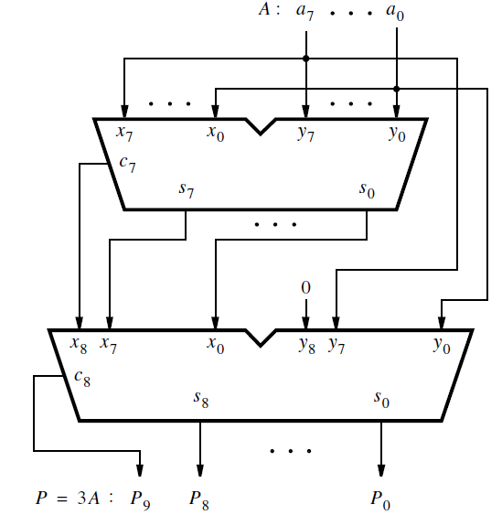
Design Example
Design a circuit that multiplies an eight-bit unsigned number by 3.
Let A = a₇a₆ · · · a₁a₀ denote the number and P = p₉p₈ · · · p₁p₀ denote the product P = 3A.
Note that 10 bits are needed to represent the product.
A simple approach to design the required circuit is to use two ripple-carry adders to add three copies of the number as shown in figure.
The symbol that denotes each adder is a commonly-used graphical symbol for adders.

Slide 33
The letters x_{i} , y_{i} , s_{i} , and c_{i} indicate the meaning of the inputs and outputs.
The first adder produces A + A = 2A.
Its result is represented as eight sum bits and the carry from the most-significant bit.
The second adder produces 2A + A = 3A.
It has to be a nine-bit adder to be able to handle the nine bits of 2A, which are generated by the first adder.
Because the y_{i} inputs have to be driven only by the eight bits of A, the ninth input y₈ is connected to a constant 0.

Slide 34
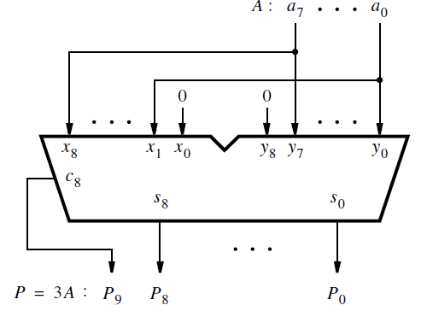
Efficient design of 3A circuit
The earlier approach is straightforward, but not very efficient.
Because 3A = 2A + A, we can observe that 2A can be generated by shifting the bits of A one bit-position to the left, which gives the bit pattern a₇a₆a₅a₄a₃a₂a₁a₀0.
Then a single ripple-carry adder suffices for implementing 3A, as shown in Figure.
This is essentially the same circuit as the second adder in previous case with 9 bit inputs.
Note that the input x₀ is connected to a constant 0.
Note also that in the second adder in previous case also the value of x₀ is always 0, even though it is driven by the least-significant bit, s₀, of the sum of the first adder.
Because x₀ = y₀ = a₀ in the first adder, the sum bit s₀ will be 0, whether a₀ is 0 or 1.

Slide 35
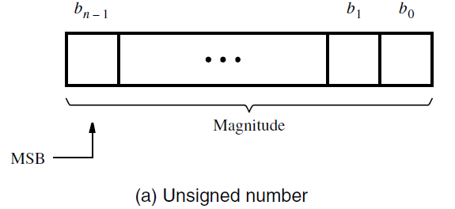
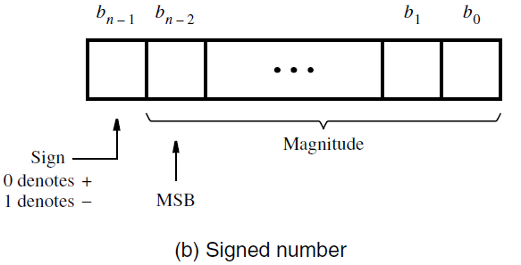
Signed Numbers
In the decimal system the sign of a number is indicated by a + or − symbol to the left of the most-significant digit.
In the binary system the sign of a number is denoted by the left-most bit.
For a positive number the left-most bit is equal to 0, and for a negative number it is equal to 1.
Therefore, in signed numbers the left-most bit represents the sign, and the remaining n − 1 bits represent the magnitude.
It is important to note the difference in the location of the most-significant bit (MSB).
In unsigned numbers all bits represent the magnitude of a number; hence all n bits are significant in defining the magnitude.
In signed numbers there are n − 1 significant bits, and the MSB is in bit position b_{n−2}.

Slide 36
Binary - Negative Numbers
Positive numbers are represented using the positional number representation as explained in the previous section.
Negative numbers can be represented in three different ways:
1) sign-and-magnitude representation,
2) 1’s complement representation,
3) 2’s complement representation

Slide 37
Sign-and-Magnitude Representation:
In the familiar decimal representation, the magnitude of both positive and negative numbers is expressed in the same way.
The sign symbol distinguishes a number as being positive or negative. This scheme is called the sign-and-magnitude number representation.
The same scheme can be used with binary numbers in which case the sign bit is 0 or 1 for positive or negative numbers, respectively.
For example, if we use four-bit numbers, then +5 = 0101 and −5 = 1101.
Because of its similarity to decimal sign-and-magnitude numbers, this representation is easy to understand.
However, this representation is not well suited for use in computers.
More suitable representations are based on complementary systems.

Slide 38
1’s Complement Representation
In a complementary number system, the negative numbers are defined according to a subtraction operation involving positive numbers.
In the 1’s complement scheme, an n-bit negative number, K, is obtained by subtracting its equivalent positive number, P, from 2^{n} − 1; that is, K = (2^{n} − 1) − P.
For example, if n = 4, then K = (2⁴ − 1) − P = (15)₁₀ − P = (1111)₂ − P.
For e.g. if K= −5. Then K = 1111 − 0101 = 1010.
Similarly, +3 = 0011 and −3 = 1111 − 0011 = 1100.
Clearly, the 1’s complement can be obtained simply by complementing each bit of the number, including the sign bit.
While 1’s complement numbers are easy to derive, they have some drawbacks when used in arithmetic operations.

Slide 39
2’s Complement Representation
In the 2’s complement scheme, a negative number, K, is obtained by subtracting its equivalent positive number, P, from 2^{n}; namely, K = 2^{n} − P.
Using our four-bit example, −5 = 2⁴ – 5 = 10000 − 0101 = 1011, and −3 = 10000 − 0011 = 1101.
Finding 2’s complements in this manner requires performing a subtraction operation that involves borrows.
However, we can observe that if K₁ is the 1’s complement of P and K₂ is the 2’s complement of P,
Then K₁ = (2^{n} − 1) − P and K₂ = 2^{n} − P
Hence, K₂ = K₁ + 1
Thus a simpler way of finding a 2’s complement of a number is to add 1 to its 1’s complement because finding a 1’s complement is easy.
This is how 2’s complement numbers are obtained in logic circuits that perform arithmetic operations.

Slide 40
Easy Rule for Finding 2’s Complements
There is a rather easier way to compute 2’s complement.
Given a number B = b_{n−1}b_{n−2} · · · b₁b₀, its 2’s complement, K = k_{n−1}k_{n−2} · · · k₁k₀, can be found by examining the bits of B from right to left and taking the following action:
Copy all bits of B that are 0 and the first bit that is 1
Then simply complement the rest of the bits.
For example, if B = 0110, then we copy k₀ = b₀ = 0 and k₁ = b₁ = 1, and complement the rest so that k₂ = (b₂)’ = 0 and k₃ = (b₃)’ = 1.
Hence K = 1010.
As another example, if B = 10110100, then K = 01001100.

Slide 41
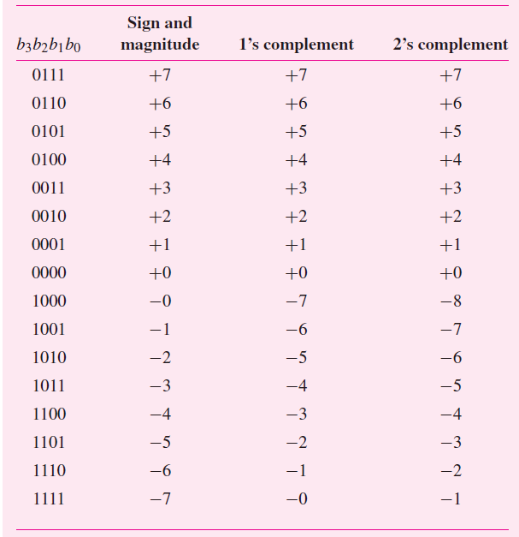
Table illustrates the interpretation of all 16 four-bit patterns in the three signed number representations that we have considered.
Note that for both sign-and-magnitude representation and for 1’s complement representation there are two patterns that represent the value zero.
For 2’s complement there is only one such pattern for zero.
Also, observe that the range of numbers that can be represented with four bits in 2’s complement form is −8 to +7, while in the other two representations it is −7 to +7.
Interpretation of four-bit signed integers.

Slide 42
Contd.
Using 2’s-complement representation, an n-bit number B = b_{n−1}b_{n−2} · · · b₁b₀ represents the value,
V(B) = (−b_{n−1} × 2^{n−1}) + b_{n−2} × 2^{n−2} +· · ·+b₁ × 2¹ + b₀ × 2⁰
Thus the largest negative number, 100 . . . 00, has the value −2^{n−1}.
The largest positive number, 011 . . . 11, has the value 2^{n−1} − 1.

Slide 43
Addition and Subtraction operations
We can compare the advantages of different number representations based on the addition and subtraction operations.
For the illustrations, we can use four-bit numbers, consisting of a sign bit and three significant bits.
Thus the numbers have to be small enough so that the magnitude of their sum can be expressed in three bits, which means that the sum cannot exceed the value 7.
Addition of positive numbers is the same for all three number representations which is same as the addition of unsigned numbers.
But there are significant differences when negative numbers are involved.

Slide 44
Sign and Magnitude Addition
If both operands have the same sign, then the addition of sign-and-magnitude numbers is simple.
The magnitudes are added, and the resulting sum is given the sign of the operands.
However, if the operands have opposite signs, the task becomes more complicated.
Then it is necessary to subtract the smaller number from the larger one.
This means that logic circuits that compare and subtract numbers are also needed.
Hence, the sign-and-magnitude representation is not used in computers.

Slide 45
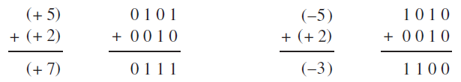
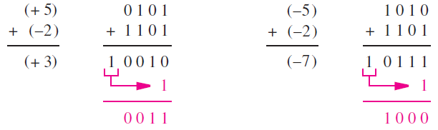
1’s Complement Addition
Advantage of the 1’s complement representation is that a negative number is generated simply by complementing all bits of the corresponding positive number.
Consider the figure below,
As seen above, the computation of 5 + 2 = 7 and (−5) + 2 = (−3) is straightforward
a simple addition of the operands gives the correct result.
But, Computing 5 + (−2) = 3 produces the bit vector 10010 which
is not 3 and there is a carry-out from the sign-bit position.
But, if we add the carry to 10010, we get 0011 which is 3 and is the
desired result.

Slide 46
Contd..
A similar situation arises when adding (−5) + (−2) = (−7).
After the initial addition the result is wrong because the four bits of the sum are 0111, which represents +7 rather than −7.
But again, there is a carry-out from the sign-bit position, which can be used to correct the result by adding it in the LSB position, as shown in Fig.
The conclusion from these examples is that the addition of 1’s complement numbers may or may not be simple.
In some cases a correction is needed, which amounts to an extra addition that must be performed.
Consequently, the time needed to add two 1’s complement numbers may be twice as long as the time needed to add two unsigned numbers.

Slide 47
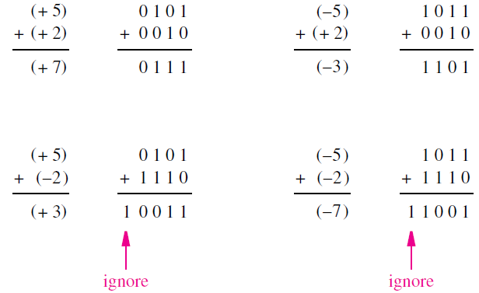
2’s Complement Addition
Lets take the same combinations of numbers as used in the 1’s complement example.
Figure indicates how the addition is performed using 2’s complement numbers.
Adding 5 + 2 = 7 and (−5) + 2 = (−3) is straightforward.

Slide 48
The computation 5 + (−2) = 3 generates the correct four bits of the result, namely 0011.
There is a carry-out from the sign-bit position, which we can simply ignore.
The fourth case is (−5) + (−2) = (−7). Again, the four bits of the result, 1001, give the correct sum (−7).
In this case also, the carry-out from the sign-bit position can be ignored.
As illustrated by these examples, the addition of 2’s complement numbers is very simple.
When the numbers are added, the result is always correct.
If there is a carry-out from the sign-bit position, it is simply ignored.
Therefore, the addition process is the same, regardless of the signs of the operands and can be performed by an adder circuit, such as the n-bit ripple carry adder.
Hence the 2’s complement notation is highly suitable for the implementation of addition operations with operands of any signs.

Slide 49
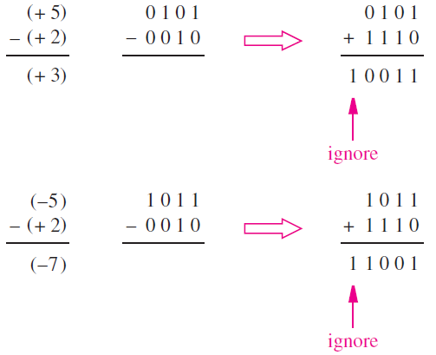
2’s Complement Subtraction
The easiest way of performing subtraction is to negate the subtrahend and add it to the minuend.
This is done by finding the 2’s complement of the subtrahend and then performing the addition.
The operation 5 − (+2) = 3 involves finding the 2’s complement of +2, which is 1110. When this number is added to 0101, the result is 0011 = (+3) and a carry-out from the sign-bit position occurs, which is ignored.
A similar situation arises for (−5) − (+2) = (−7). In the remaining two cases there is no carry-out, and the result is correct.

Slide 50
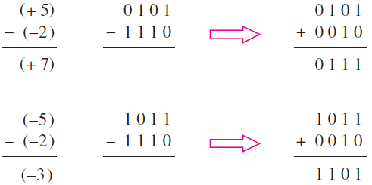
Contd..
Similarly, 5-(-2) & - 5-(-2), we have to take the 2’s complement of (-2) which is 2 itself.

Slide 51
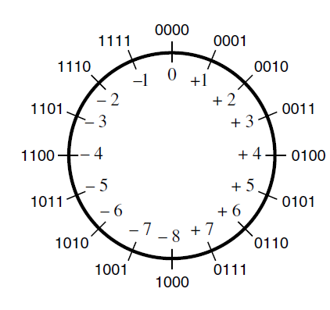
Graphical interpretation of four-bit 2’s complement numbers (Modulo-16 circle)
As a graphical aid to visualize the addition and subtraction examples we have seen, we can place all possible four-bit patterns on a modulo-16 circle given in figure.
If the bit patterns represented unsigned integers, they would be numbers 0 to 15.
If bit patterns represent 2’s-complement integers, then the numbers range from −8 to +7, as shown.
The addition operation is done by stepping in the clockwise direction by the magnitude of the number to be added.
For example, −5 + 2 is determined by starting at 1011 (= −5) and moving clockwise two steps, giving the result 1101 (= −3).

Slide 52
Contd..
Subtraction can be performed on the modulo-16 circle by moving in the counter-clockwise direction.
Using the example of 5 − 2 = 3, we can start at 0101 (= +5) and move counter-clockwise by two steps, which gives 0011 (= +3).
So in conclusion, the subtraction operation can be realized as the addition operation, using a 2’s complement of the subtrahend, regardless of the signs of the two operands.
Therefore, the same adder circuit can perform both addition and subtraction with some modifications.

Slide 53
Adder and Subtractor Unit
The only difference between performing addition and subtraction is that for subtraction it is necessary to use the 2’s complement of one operand.
So we can use an adder to also perform subtraction.
Let X and Y be the two operands, such that Y serves as the subtrahend.
A 2’s complement can be obtained by adding 1 to the 1’s complement of Y .
Adding 1 in the least-significant bit position can be accomplished simply by setting the carry-in bit c₀ to 1.
A1’s complement of a number is obtained by complementing each of its bits.
This could be done with NOT gates, but we need a more flexible circuit where we can use the true value of Y for addition and its complement for subtraction
But, a two-input XOR gate can be used to choose between true and complemented versions of an input value, under the control of the other input.

Slide 54
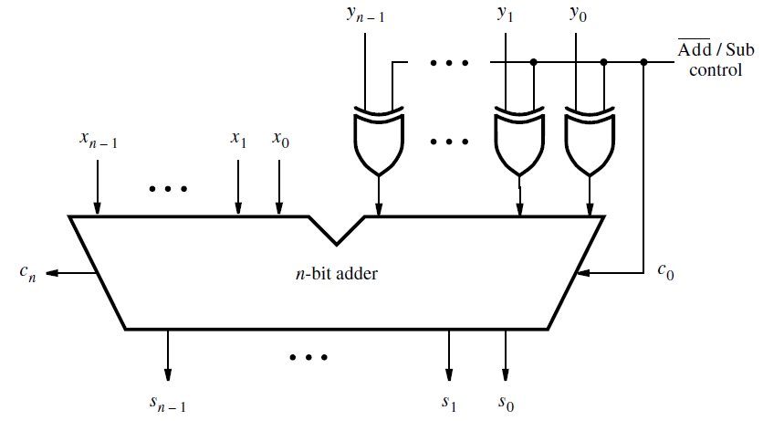
Adder and Subtractor Circuit
The main part of the circuit is an n-bit adder, which can be implemented using the ripple-carry structure.
Assume that there exists a control signal that chooses whether addition or subtraction is to be performed.
Let this signal be called Add/Sub. Also, let its value be 0 for addition and 1 for subtraction.

Slide 55
Note that the control signal Add/Sub is also connected to the carry-in c₀.
This makes c₀ = 1 when subtraction is to be performed, thus adding the 1 that is needed to form the 2’s complement of Y .
When the addition operation is performed, we will have c₀ = 0.
The combined adder/subtractor unit is a good example of an important concept in the design of logic circuits.
It is useful to design circuits to be as flexible as possible and to exploit common portions of circuits for as many tasks as possible.
This approach minimizes the number of gates needed to implement such circuits, and it reduces the wiring complexity substantially.

Slide 56
Radix-Complement Schemes
The 2’s complement scheme is just a special case of radix-complement schemes for any number ‘r’
The idea of performing a subtraction operation by addition of a complement of the subtrahend is not restricted to binary numbers.
It can also be done for the decimal number system.
Consider the subtraction of two-digit decimal numbers.
Computing a result such as 74 −33 = 41 is simple because no borrow is needed in the computation.
But computing 74 − 36 = 38 is not as simple because a borrow is needed in subtracting the least-significant digit.

Slide 57
Contd.
Suppose that we restructure the computation of 74-36 as follows:
74 − 36 = 74 + 100 − 100 − 36
= 74 + (100 − 36) − 100
But we can write 100 = 99 + 1.
Hence, 74 − 36 = 74 + (99 + 1 − 36) − 100
= 74 + (99 − 36) + 1 − 100
The subtraction in parentheses does not require borrows; it is performed by subtracting each digit of the subtrahend from 9.
We can see a direct correlation between this expression and the one used for 2’s complement.
(99 − 36) is analogous to complementing the subtrahend to find its 1’s complement, which is the same as subtracting each bit from 1.
Using decimal numbers, we find the 9’s complement of the subtrahend by subtracting each digit from 9.
In our decimal example we perform (99 − 36) + 1 = 64. It is the 10’s complement of 36.

Slide 58
10’s complement scheme
For an n-digit decimal number, N, its 10’s complement, K₁₀, is defined as K₁₀ = 10^{n} − N
While its 9’s complement, K₉, is K₉ = (10^{n} − 1) − N.
Thus the required subtraction (74 − 36) can be performed by addition of the 10’s complement of the subtrahend, as in:
74 − 36 = 74 + 64 − 100 = 138 − 100 = 38
The subtraction 138 − 100 is trivial because it means that the leading digit in 138 is simply deleted.
This is analogous to ignoring the carry-out in case of 2’s complement based subtraction.

Slide 59
Contd.
Suppose that A and B are n-digit decimal numbers. Using the 10’s-complement approach, B can be subtracted from A as follows:
A − B = A + (10^{n} − B) − 10^{n}
If A ≥ B, then the operation A + (10^{n} − B) produces a carry-out of 1. This carry is equivalent to 10^{n} hence it can be simply ignored.
But if A < B, then the operation A + (10^{n} − B) produces a carry-out of 0.
Let the result obtained be M, so that A − B = M − 10^{n}
We can rewrite this as 10^{n} − (B − A) = M
The left side of this equation is the 10’s complement of (B − A).
The 10’s complement of a positive number represents a negative number that has the same magnitude.
Hence M correctly represents the negative value obtained from the computation A − B when A < B.

Slide 60
Contd.
For binary signed numbers we use 0 in the left-most bit position to denote a positive number and 1 to denote a negative number.
Similarly, for signed decimal numbers, 0 in the left-most digit position denote a positive number and 9 denote a negative number.
Note that 9 is the 9’s complement of 0 in the decimal system, just as 1 is the 1’s complement of 0 in the binary system.
If we use three-digit signed numbers, A = 045 and B = 027
Then, A − B = 045 − 027
= 045 + 1000 − 1000 − 027
= 045 + (999 − 027) + 1 − 1000
= 045 + 972 + 1 − 1000
= 1018 − 1000
= 018 (Correct answer)

Slide 61
Contd.
Next consider the case where the minuend has lower value than the subtrahend.
B − A = 027 − 045
= 027 + 1000 − 1000 − 045
= 027 + (999 − 045) + 1 − 1000
= 027 + 954 + 1 − 1000
= 982 − 1000
But, this can be rewritten as
982 = 1000 + B − A
= 1000 − (A − B)
Therefore, 982 is the negative number that results when forming the 10’s complement of (A − B).

Slide 62
General Radix Complement
The concept of subtracting a number by adding its radix-complement is general.
If the radix is r, then the r’s complement, K_{r}, of an n-digit number, N, is determined as:
K_{r} = r^{n} − N.
The (r − 1)’s complement, K_{r−1}, is defined as K_{r−1} = (r^{n} − 1) − N
it is computed simply by subtracting each digit of N from the value (r − 1).
The (r − 1)’s complement is referred to as the diminished-radix complement.
Circuits for forming the (r − 1)’s complements are simpler than those for general subtraction that involves borrows.
The circuits are particularly simple in the binary case, where the 1’s complement requires just inverting each bit.

Slide 63
Contd.
Consider the computation (+5) − (+2) = (+3), using the same approach discussed for decimal numbers.
Each number is represented by a four-bit pattern.
The value 2⁴ is represented as 10000. Then
0101 − 0010 = 0101 + (10000 − 0010) − 10000
= 0101 + (1111 − 0010) + 1 − 10000
= 0101 + 1101 + 1 − 10000
= 10011 − 10000
= 0011
Because 5 > 2, there is a carry from the fourth bit position.
It represents the value 2⁴ denoted by the pattern 10000.

Slide 64
Contd.
Consider now the computation (+2) − (+5) = (−3), which gives
0010 − 0101 = 0010 + (10000 − 0101) − 10000
= 0010 + (1111 − 0101) + 1 − 10000
= 0010 + 1010 + 1 − 10000
= 1101 − 10000
Because 2 < 5, there is no carry from the fourth bit position.
The answer, 1101, is the 2’s-complement representation of −3.
But, 1101 = 10000 + 0010 − 0101
= 10000 − (0101 − 0010)
= 10000 − 0011
It indicates that 1101 is the 2’s complement of 0011 (+3).

Slide 65
Contd.
Finally, consider the case where the subtrahend is a negative number.
(+5) − (−2) = (+7) is done as follows:
0101 − 1110 = 0101 + (10000 − 1110) − 10000
= 0101 + (1111 − 1110) + 1 − 10000
= 0101 + 0001 + 1 − 10000
= 0111 − 10000
While 5 > (−2), the pattern 1110 is greater than the pattern 0101 when the patterns are treated as unsigned numbers. Therefore, there is no carry from the fourth bit position.
But, 0111 = 10000 + 0101 − 1110
= 10000 − (1110 − 0101)
= 10000 − 1001
and 1001 represents −7.
The answer 0111 is the 2’s complement representation of 1001. Thus, 0111 is +7.

Slide 66
Arithmetic Overflow
If the result of addition or subtraction is not within the significant bits used to represent the numbers then there is arithmetic overflow.
If n bits are used to represent signed numbers, then the result must be in the range −2^{n−1} to 2^{n−1} − 1. If the result does not fit in this range, then we say that arithmetic overflow has occurred.
To ensure the correct operation of an arithmetic circuit, it is important to be able to detect the occurrence of overflow.
The key to determining whether overflow occurs is the carry-out from the MSB position and also from the sign-bit position.
Overflow occurs when these carry-outs have different values, and a correct sum is produced when they have the same value.
This is true in general for both addition and subtraction of 2’s-complement numbers.

Slide 67
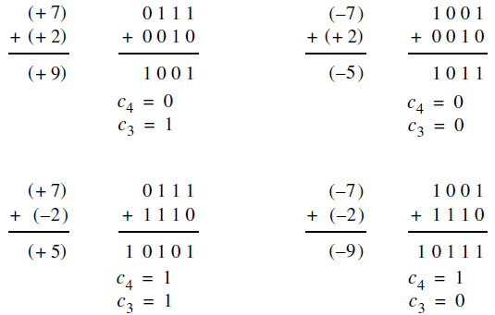

Examples of overflow
If use four-bit numbers, then there will be three significant bits, b₂₋₀.
The occurrence of overflow is detected by
Overflow = $\overline{\text{c}\text{3}}$c₄ + c₃$\overline{\text{c}\text{4}}$= c₃ ⊕ c₄
Thus, for n-bit numbers we have overflow = c_{n−1} ⊕ c_{n}
Thus the adder/subtractor circuit can be modified to include overflow checking with the addition of one XOR gate.

Slide 68
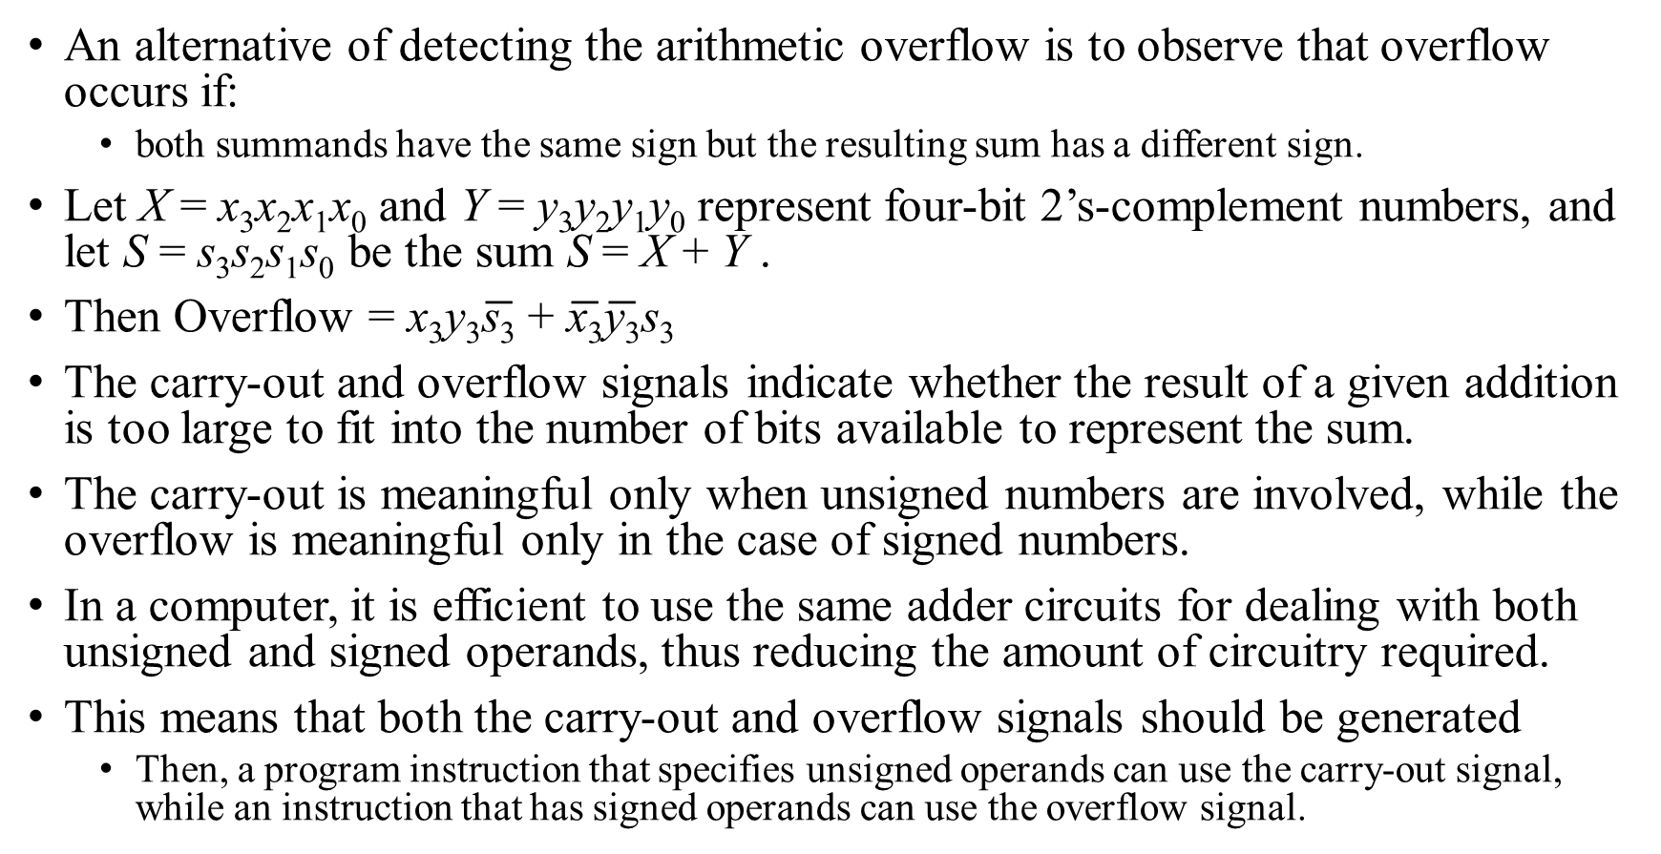
Contd.
An alternative of detecting the arithmetic overflow is to observe that overflow occurs if:
both summands have the same sign but the resulting sum has a different sign.
Let X = x₃x₂x₁x₀ and Y = y₃y₂y₁y₀ represent four-bit 2’s-complement numbers, and let S = s₃s₂s₁s₀ be the sum S = X + Y .
Then Overflow = x₃y₃$\overline{\text{s}\text{3}}$ + $\overline{\text{x}\text{3}}\overline{\text{y}\text{3}}$s₃
The carry-out and overflow signals indicate whether the result of a given addition is too large to fit into the number of bits available to represent the sum.
The carry-out is meaningful only when unsigned numbers are involved, while the overflow is meaningful only in the case of signed numbers.
In a computer, it is efficient to use the same adder circuits for dealing with both unsigned and signed operands, thus reducing the amount of circuitry required.
This means that both the carry-out and overflow signals should be generated
Then, a program instruction that specifies unsigned operands can use the carry-out signal, while an instruction that has signed operands can use the overflow signal.

Slide 69
Performance Issues
When buying a digital system, the performance as well as the cost are important.
A large increase in performance can often be achieved at a small increase in cost.
A commonly used indicator of the value of a system is its price/performance ratio.
The addition and subtraction of numbers are fundamental operations that are performed frequently in the course of a computation.
The speed with which these operations are performed has a strong impact on the overall performance of a computer.
Now, let us take a closer look at the speed of the adder/subtractor unit we designed.
We are interested in the largest delay from the time the operands X and Y are presented as inputs, until the time all bits of the sum S and the final carry-out, c_{n}, are valid.
Most of this delay is caused by the n-bit adder circuit.

Slide 70
Contd.
Assume that the adder is implemented using the ripple carry structure with each full-adder as shown.
The delay for the carry-out signal in this circuit, Δt, is equal to two gate delays.

Slide 71
Contd.
The final result of the addition will be valid after a delay of n Δ t, which is equal to 2n gate delays.
In addition to the delay in the ripple-carry path, there is also a delay in the XOR gates that feed either the true or complemented value of Y to the adder inputs.
If this delay is equal to one gate delay, then the total delay is 2n + 1 gate delays.
For a large n, say n = 32 or n = 64, the delay would lead to unacceptably poor performance.
Therefore, it is important to find faster circuits to perform addition.
The speed of any circuit is limited by the longest delay along the paths through the circuit.
In this case, the longest delay is along the path from the y_{i} input, through the XOR gate and through the carry circuit of each adder stage.
The longest delay is often referred to as the critical-path delay, and the path that causes this delay is called the critical path.

Slide 72
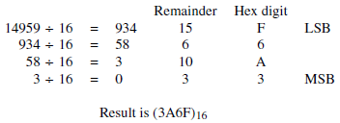
Problem: Convert the decimal number 14959 into a hexadecimal number.
Solution: An integer is converted into the hexadecimal representation by successive divisions by 16, such that in each step the remainder is a hex digit.
Consider a four-digit number H = h₃h₂h₁h₀. Its value is
V = h₃ × 16³ + h₂ × 16² + h₁ × 16 + h₀
If we divide this by 16, we obtain V/16
= h₃ × 16² + h₂ × 16 + h₁ + h₀/16
Thus, the remainder gives h₀.
Finally, (14959)₁₀ = (3A6F)₁₆.

Slide 73
Problem: Convert the decimal fraction 0.8254 into binary representation.
Solution: A binary fraction is represented as the bit pattern B = 0.b₋₁b₋₂ · · · b_{−m} and its value is
V = b₋₁ × 2⁻¹ + b₋₂ × 2⁻² +· · ·+b_{−m} × 2^{−m}
Multiplying this expression by 2 gives
V × 2 = b₋₁ + b₋₂ × 2⁻¹ +· · ·+b_{−m} × 2^{−(m−1)}
Here, the left-most term is the first bit to the right of the radix point.
The remaining terms constitute another binary fraction
To convert a decimal fraction into a binary fraction,
we multiply the decimal number by 2 and
set the computed bit to 0 if the product is less than 1 and
set it to 1 if the product is greater than or equal to 1.
repeat this calculation until a sufficient number of bits are obtained to meet the desired accuracy.

Slide 74
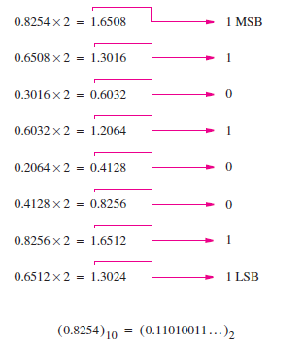
Contd.
Thus, (0.8254)₁₀ = (0.11010011 . . .)₂.
Note that it may not be possible to represent a decimal fraction with a binary fraction that has exactly the same value.

Slide 75
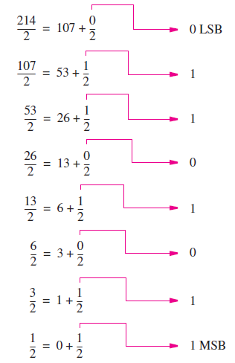
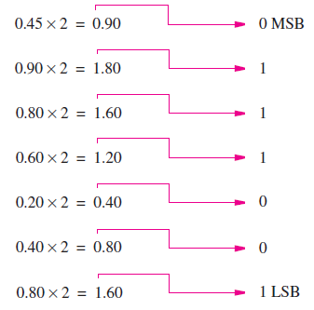
Problem : Convert the decimal fixed point number 214.45 into a binary fixed point number.
Solution: For the integer part perform successive division by 2 and we get 11010110
For the fractional part perform successive multiplication by 2 and we get 0111001 . .
The complete computation is presented in Figure 3.44, producing (214.45)₁₀ = (11010110.0111001 . . .)₂.

